Slide 2
Protection by Design: Intel SGX and Azure Confidential Computing
THR2240
Lang Wong
Director of Engineering, Cloud Service Providers
Intel

Slide 3


Forces Impacting Security Challenges in implementing, maintaining, and protecting products and processes
FRAGMENTATION
INDUSTRIALIZATION
EXPANSION
of Security Offerings
of Hacking
of Attack Surface
110101010
011101011
000011101101011001
Thousands of security related products from hundreds of vendors
Criminal sophistication and evolving intent
to get to your data
Billions of connected devices and the
move to the cloud

Slide 4
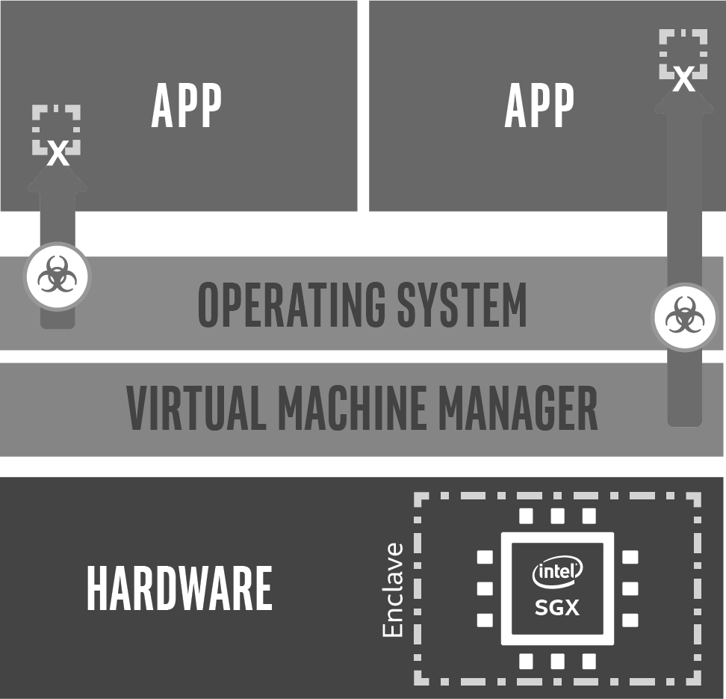
Trusted Execution Environment (TEE)
Intel® Software Guard Extensions
(Intel® SGX)
Protects against:
Malicious insiders
External attackers
3rd-Parties without consent
Secure Enclave

Slide 5
Encrypt data at rest
Encrypt data in use
Encrypt
data in transit

Slide 6
Intel® SGX Intel SGX provides a trusted computing enclave (island) where data and applications are protected independently of the operating system or hardware configuration itself.
Untrusted - CSP Environment
Protects against SW attacks even if OS/drivers/ BIOS/VMM/SMM are compromised
Smallest possible Trusted Compute Block (TCB)
Secrets (data/keys/et al) remain protected even when attacker has full control of platform
Other technologies allow some privileged SW in their boundary
Prevents attacks like memory bus snooping, memory tampering, and “cold boot” attacks against memory contents in RAM
Protection for hard-to-protect or unprotected spaces
Provides hardware-based attestation capabilities to measure and verify valid code and data signatures
Increases transparency and accountability
Azure Confidential Cloud &
Data Provider
Encrypted Data
Trusted – Intel® SGX enclave
Protected
Application
Protected Input Data
Encrypted Results
Secrets
Ex. SSN, City, Credit Card Number

Slide 7
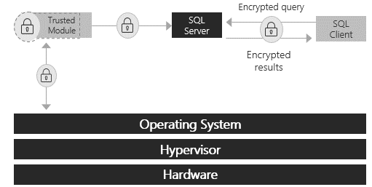
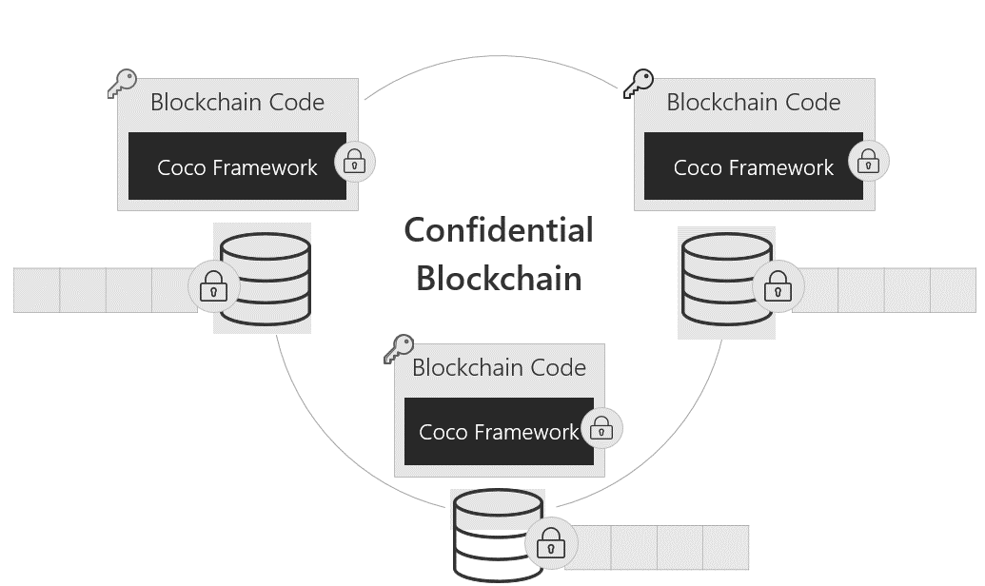
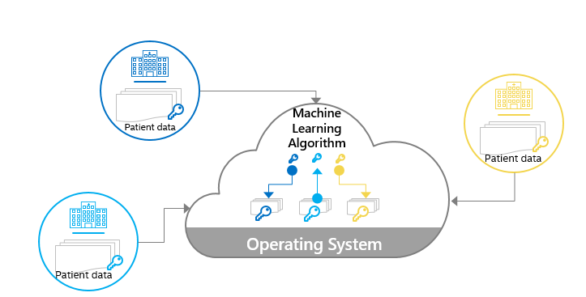
Azure Confidential Cloud Trusted Execution Environments (TEE’s)
Encrypt data at rest
Encrypt data in use
All use cases are currently 128MB EPC enabled
Current Use Cases:
Encrypt
data in transit
Confidential SQL
Blockchain
Confidential Multiparty Machine Learning

Slide 8
Open Enclave SDK
Driving towards a consistent API surface around enclaving abstraction, supporting portability across enclave types and flexibility in architecture
Universal
Generalize enclave application model to minimize hardware/ software specific concepts
Pluggable
Componentization to support desired runtimes and crypto libraries
Standardized
Remove hardware vendor specific signing and verification requirements
Multi-platform
Design with all software platforms, Windows and Linux, in mind
Compatible
Easier enablement of redistributable applications
Open
Open source and a standard for secure enclave-based application development

Slide 9

Get Started Today
Rob Lefferts, Vice President, Microsoft, Security Blog
https://cloudblogs.microsoft.com/microsoftsecure/?p=85528
Corey Sanders, Director, Microsoft- Infrastructure Blog https://aka.ms/azureinfraIgnite2018
Confidential Computing Product Page https://aka.ms/AzureConfidentialCompute

Slide 10
Please evaluate this session Your feedback is important to us!
Please evaluate this session through MyEvaluations on the mobile app or website.
Download the app: https://aka.ms/ignite.mobileApp
Go to the website: https://myignite.techcommunity.microsoft.com/evaluations

